Slide 1
Lecture 2
Operational Amplifier:
Introduction, Open Loop Configuration, Closed Loop Introduction

Slide 2
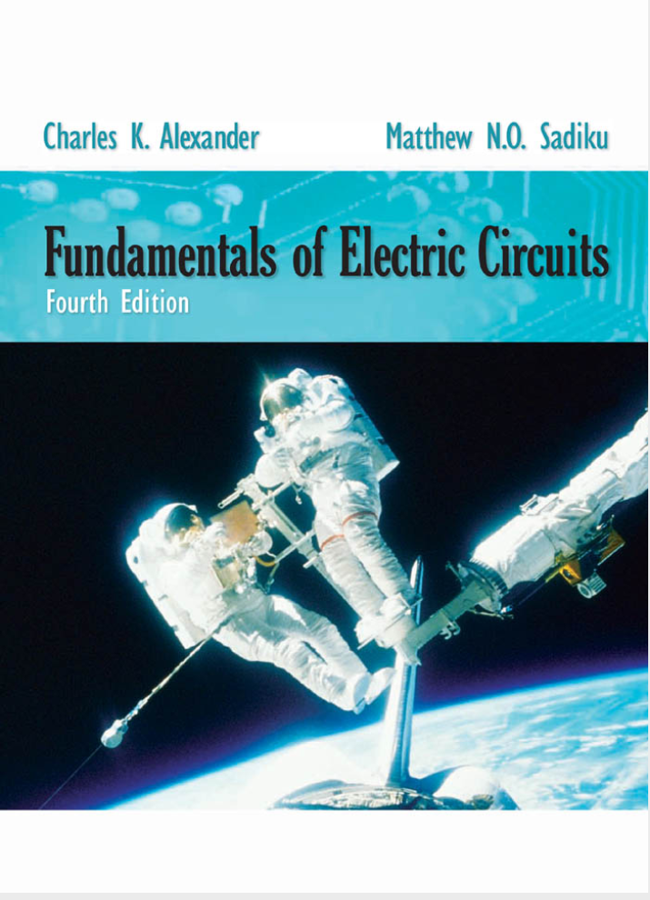
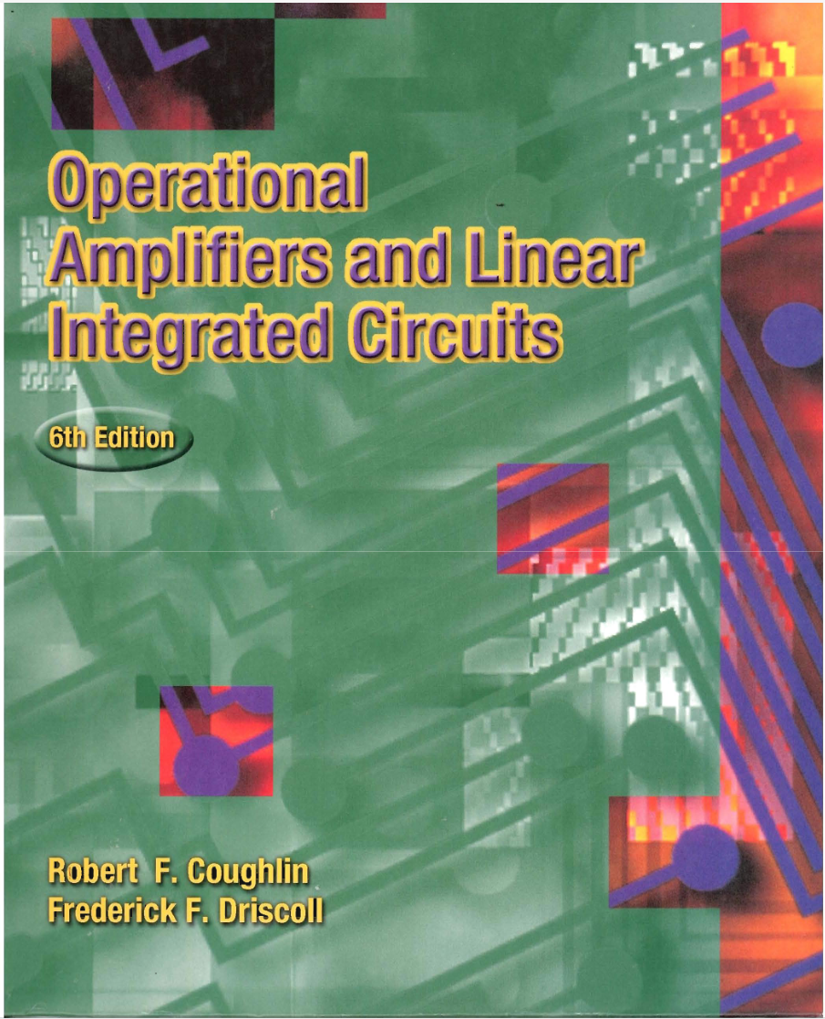
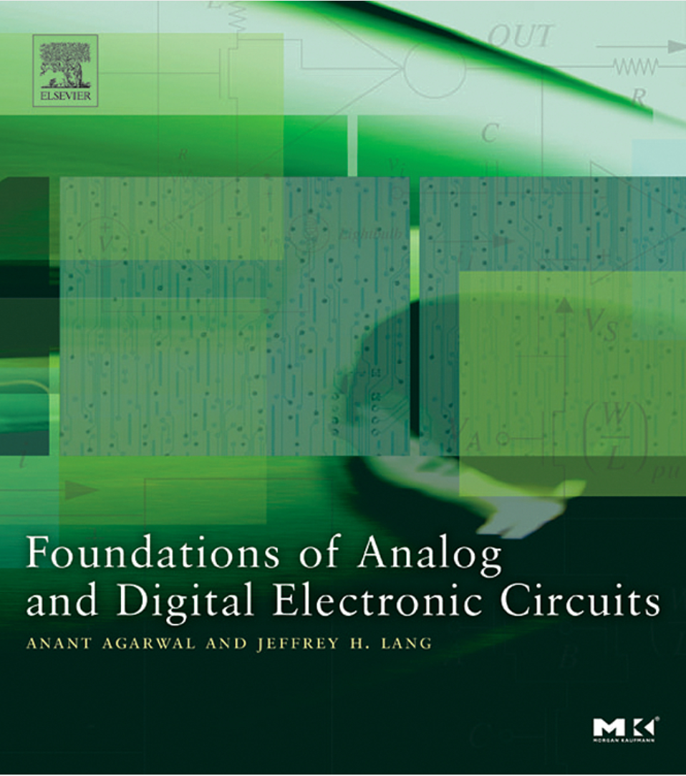
Operational Amplifiers
Textbook

Slide 3
Outline
Operational Amplifier: Introduction
- Dependent Sources
- Op-Amp: Circuit Symbols and terminal
- Op-Amp: VTC (Voltage Transfer Characteristics)
Linear Amplification
(Positive and Negative) Saturation
- Op-Amp: Examples
- Op-Amp: Physical Entity

Slide 4
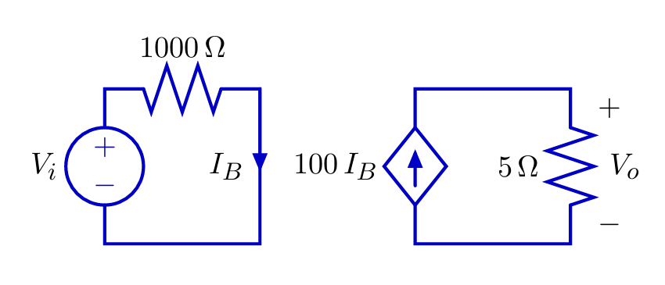
Dependent Sources
To analyze op-amps, we must understand dependent source.
A dependent source generates a voltage or current whose value depends on another voltage or current.
Example: current-controlled current source

Slide 5
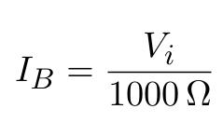
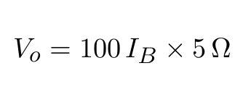
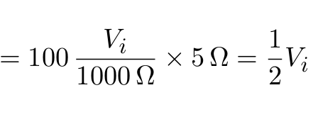
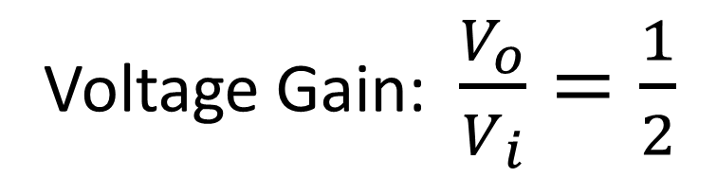
Dependent Sources
Voltage Gain: $\frac{V_{o}}{V_{i}}=\frac{1}{2}$

Slide 6
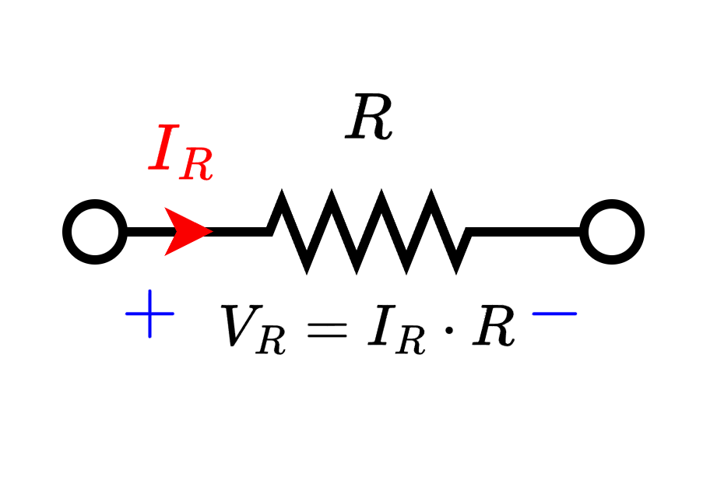
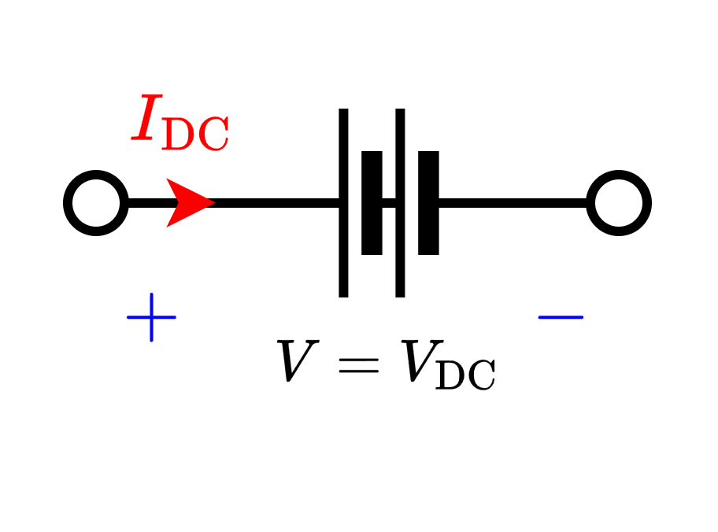
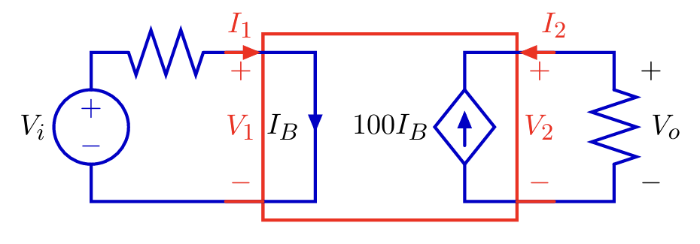
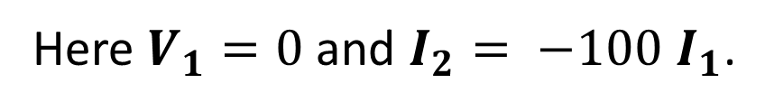
Dependent Sources
Resistors, (Ind.) Voltage sources, (Ind.) Current sources are single “port” device. They are characterized by a single equation.
Dependent sources are two-ports: characterized by two equations.
Here $V_{1}=0$and $I_{2}= −100 I_{1}$.

Slide 7
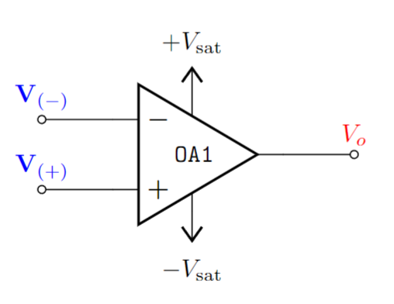
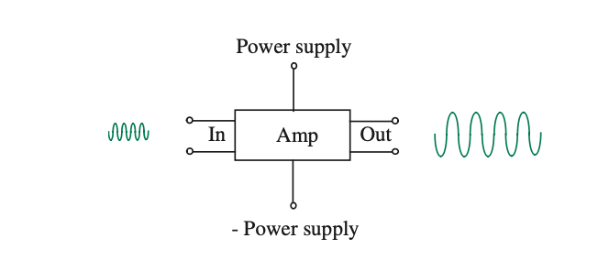
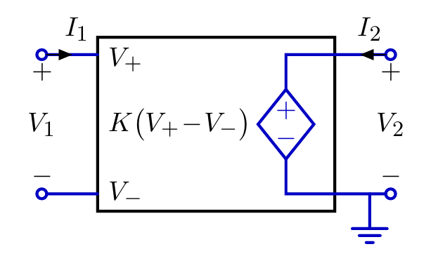
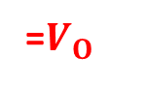
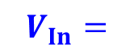
Operational Amplifier: Introduction
Operational:
Mathematical Operations
Amplifier:
Amplifies input signal/voltage.
Large Signal
Small Signal
An op-amp (operational amplifier) can be modelled by a voltage- controlled voltage source.
Small Signal
Large Signal
$$V_{In}=$$
=$V_{O}$

Slide 8

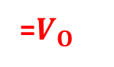
Operational Amplifier: Introduction
An op-amp (operational amplifier) can be represented by a voltage- controlled voltage source.
Small Signal
Large Signal
$$V_{In}=$$
=$V_{O}$
$I_{1} = 0$and $V_{O} = KV_{In}$ where $K$ is large (typically $K > {10}^{5}$).

Slide 9
Op-Amp: Circuit Symbols and terminal
Positive Saturation / Supply Voltage
Inverting terminal voltage
Output Voltage
Non-inverting terminal voltage
Negative Saturation / Supply Voltage

Slide 10

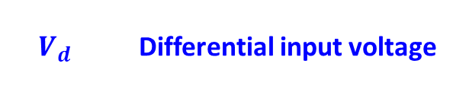
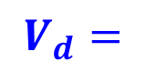
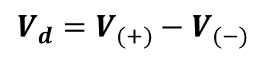

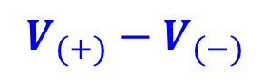
Op-Amp: Circuit Symbols and terminal
Difference Amplifier –
Amplifies the voltage difference between two terminals.
$$V_{d}=V_{(+)}−V_{(−)}$$
$$V_{d}$$ | Differential input voltage
Voltage Transfer Characteristics (VTC)
$$V_{O}$$
$$V_{d}=$$
=$V_{O}$
$$V_{(+)}−V_{(−)}$$

Slide 11
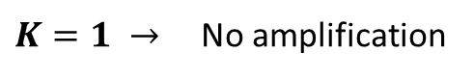
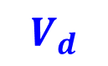
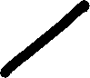

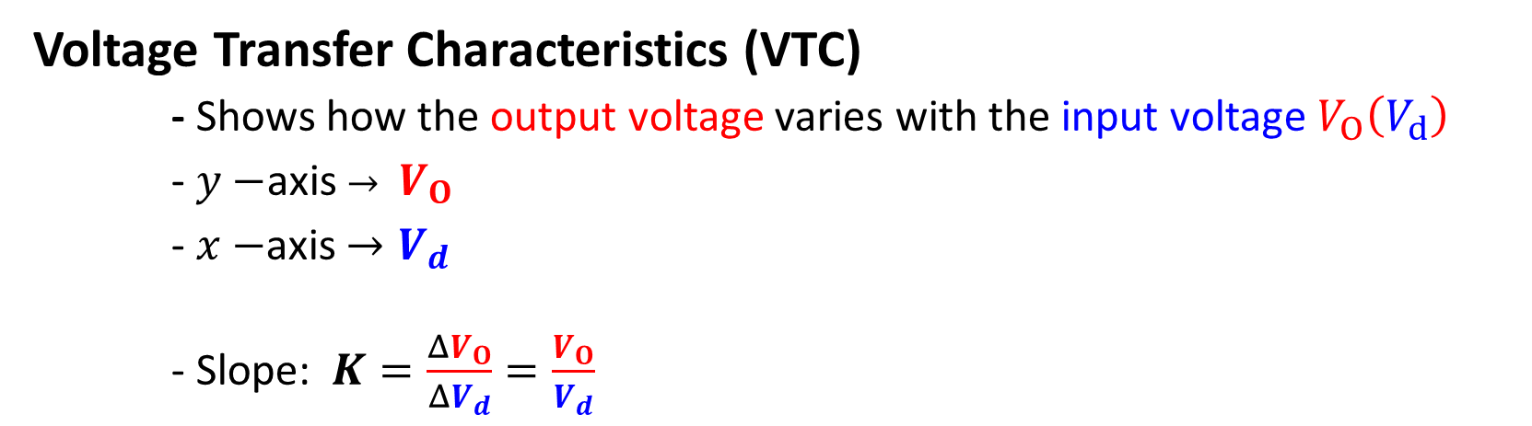
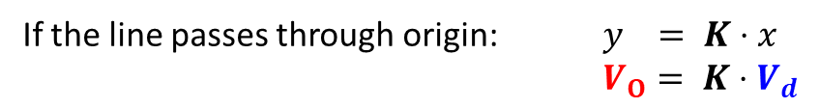
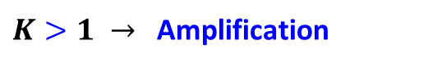
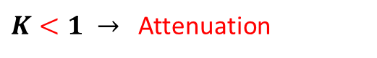

Op-Amp: VTC – Linear Amplification
Voltage Transfer Characteristics (VTC)
- Shows how the output voltage varies with the input voltage $V_{O}\left(V_{d}\right)$
- $y−$axis $→ V_{O}$
- $x−$axis $→V_{d}$
- Slope: $K=\frac{ΔV_{O}}{ΔV_{d}}=\frac{V_{O}}{V_{d}}$
$$V_{O}$$
$K>1 →$ Amplification
15 V
$K=1 →$ No amplification
$K<1 →$ Attenuation
1.5 V
$$V_{d}$$
If the line passes through origin: $y = K⋅x$
$V_{O}= K⋅V_{d}$
LINEAR AMPLIFICATION

Slide 12
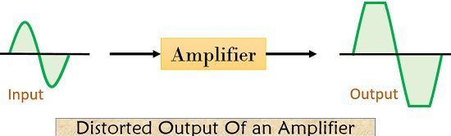
Op-Amp: VTC – Linear Amplification
Linear Amplification only takes place within a valid input range.
Otherwise output will be distorted - - Saturation
The limiting factor of linear amplification is determined by the power supply to the amplifier

Slide 13
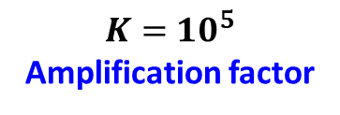
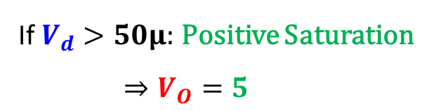
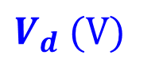
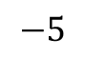
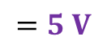
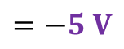
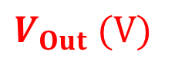
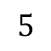
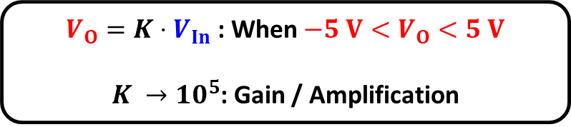
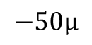
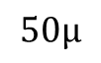
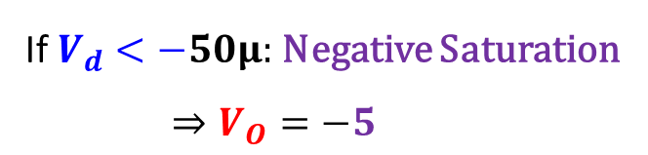
Op-Amp: VTC - Saturation
$$=5 V$$
$V_{O}=K⋅V_{In}$ : When $−5 V<V_{O}<5 V$
$K →10^{5}$: Gain / Amplification
$V_{Out}$ $(V)$
$$=−5 V$$
If $V_{d}>50μ:$Positive Saturation
$⇒V_{O}=5$
Non-Linear characteristics
$$5$$
$K=$ $10^{5}$
Amplification factor
$$−50μ$$
$$50μ$$
$V_{d}$ $(V)$
If $V_{d}<−50μ:$Negative Saturation
$⇒V_{O}=−5$
$$−5$$

Slide 14
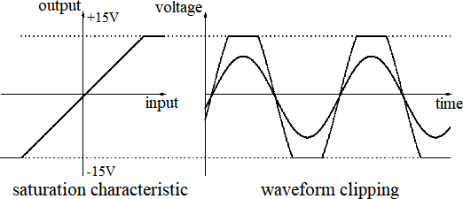
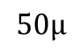
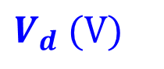
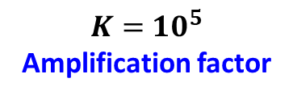
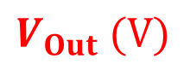
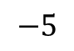
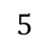
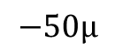
Op-Amp: VTC - Saturation
$V_{Out}$ $(V)$
$$5$$
$K=$ $10^{5}$
Amplification factor
$$−50μ$$
$$50μ$$
$V_{d}$ $(V)$
$$−5$$

Slide 15











Op-Amp: VTC - Summary
Voltage Transfer Characteristics (VTC)
$$\{$$
Positive saturation:
$$V_{d}=V_{(+)}−V_{(−)}$$
If $V_{d}>\frac{{+V}_{sat }}{A}:$Positive
$$⇒V_{O}=+V_{sat}$$
Output
axis
$$V_{O}$$
Linear Region
$V_{O}=AV_{d}$ : When $V_{d}$ is very small
$${−V}_{sat }<V_{o}=AV_{d}<{+V}_{sat }$$
$${+V}_{sat }$$
$$V_{d}$$
Negative saturation:
$$\frac{{−V}_{sat }}{A}$$
$$\frac{{+V}_{sat }}{A}$$
Input
axis
If$V_{d}<\frac{{−V}_{sat }}{A}:$ Negative
$⇒V_{O}=−V_{sat}$
$${−V}_{sat }$$

Slide 16



Op-Amp: Examples
Find $v_{0}$

Slide 17












Example 1
Solution:
$$V_{d}=V_{(+)}−V_{\left(−\right)}=\left(10−5\right) μV=5 μV$$
$$AV_{d}=\left(2×10^{5}\right)×\left(5×10^{−6}\right) V=1 V$$
$v_{O}$ $(V)$
Since $−15 V<AV_{d}<+15 V$
$$15$$
$A=$ $2×10^{5}$
$$1$$
$$V_{O}=AV_{d}=1 V$$
$$−75μ$$
$$75μ$$
$V_{d}$ $(V)$
$$−15$$

Slide 18










Example 2
Solution:
$$V_{d}=V_{(+)}−V_{\left(−\right)}=\left(0.5−1\right) mV=−0.5 mV$$
$$AV_{d}=\left(2×10^{5}\right)×\left(−0.5×10^{−3}\right) V=−100 V$$
$v_{O}$ $(V)$
Since $AV_{d}<−15 V$
(Negative saturation)
$$15$$
$A=$ $2×10^{5}$
$$V_{O}=AV_{d}=−15 V$$
$$−500μ$$
$$−75μ$$
$$75μ$$
$V_{d}$ $(V)$
$$−15$$

Slide 19







Op-Amp: Physical Entity
Difference Amplifier – Amplifies the voltage difference between two terminals.
7
NC – No Connection
2
6
3
4
$μ$A-741C
C: Commercial ($0^{∘}−{70}^{∘}C$)
I: Industrial (${−25}^{∘}−{85}^{∘}C$)
M: Military (${−55}^{∘}−{125}^{∘}C$)
Circuit symbol for the general-purpose op amp.
Pin numbering is that for an 8-pin mini-DIP package
Manufacturer ID
Part Identification Number (PIN)

Slide 20







Op-Amp: Summary
$$\{$$
Op-Amp Amplifies the difference between the voltages at it’s two input terminals - $V_{d}$
However, the Amplification is limited within voltage levels defined by the positive and negative saturation voltages $[−V_{sat}, +V_{sat}]$ .
$$V_{O}$$
$${+V}_{sat }$$
The “ideal” op-amp behaves like a voltage dependent voltage source within the linear region.
$$V_{d}$$
$$\frac{{−V}_{sat }}{A}$$
$$\frac{{+V}_{sat }}{A}$$
$${−V}_{sat }$$

Slide 21
Thank you!
Part 1 ends here

Slide 22
Outline
Op-Amp: Open Loop Configuration
Op-Amp: Circuit Modelling
Example Problem – Op-amp model
Op-amp configuration – open and closed loop
Open Loop op-amp: Voltage Transfer Characteristics
Open Loop op-amp: Comparators

Slide 23
Op-Amp (Recap)
Operational:
Mathematical Operations
Amplifier:
Amplifies input signal/voltage.
Large Signal
Small Signal
An op-amp (operational amplifier) can be represented by a voltage- controlled voltage source.
Small Signal
Large Signal
$$V_{In}=$$
=$V_{O}$

Slide 24





Op-Amp: VTC (Recap)
Voltage Transfer Characteristics (VTC)
$$\{$$
Positive saturation:
$$V_{d}=V_{(+)}−V_{(−)}$$
If $V_{d}>\frac{{+V}_{sat }}{K}:$Positive
$$⇒V_{O}=+V_{sat}$$
$$V_{O}$$
Linear Region
$V_{O}=KV_{d}$ : When $V_{d}$ is very small
$${−V}_{sat }<V_{o}=KV_{d}<{+V}_{sat }$$
$${+V}_{sat }$$
$$V_{d}$$
Negative saturation:
$$\frac{{−V}_{sat }}{K}$$
$$\frac{{+V}_{sat }}{K}$$
If$V_{d}<\frac{{−V}_{sat }}{K}:$ Negative
$⇒V_{O}=−V_{sat}$
$${−V}_{sat }$$

Slide 25






Op-Amp: Circuit Modelling
Voltage controlled voltage Source
“Ideal” op-amp approximation
$$\{$$
$$V_{d}=V_{(+)}−V_{(−)}$$
$$V_{d}=$$
$$V_{(+)}≈V_{\left(−\right)}$$
$$I_{1}≈0$$

Slide 26







Op-amp: Circuit Model and VTC
Voltage (Differential/OL) Gain: $A/A_{OL}$ or $K$
Positive Saturation Voltage: $+V/V_{CC}/V_{sat}$
Negative Saturation Voltage: $−V/V_{EE}/−V_{sat}$
Slope of VTC
Parameter | Typical Range | Ideally
$$A or K$$ | $${10}^{4}−{10}^{8}$$ | $$∞$$
$$V_{O}$$
$${+V}_{sat }$$
$$V_{d}=$$
$$\frac{{−V}_{sat }}{K}$$
$$\frac{{+V}_{sat }}{K}$$
Input
axis
$${−V}_{sat }$$

Slide 27













Op-amp: Circuit Model and VTC
Voltage Transfer Characteristics (VTC)
$$\{$$
Positive saturation:
$$V_{d}>0$$
$$V_{d}=V_{(+)}−V_{(−)}$$
$$⇒V_{O}=+V_{sat}$$
$A →∞$ : Open Loop Gain
Linear Region
$${−V}_{sat }<V_{O}=AV_{d}<{+V}_{sat }$$
$$V_{O}$$
$${+V}_{sat }$$
Negative saturation:
$$V_{d}<0$$
$$⇒V_{O}=−V_{sat}$$
$$\frac{{−V}_{sat }}{A}$$
$$\frac{{+V}_{sat }}{A}$$
$$V_{d}$$
$${−V}_{sat }$$

Slide 28

Types of Op-Amp configuration
Open loop configuration:
No physical connection between input and output
Closed loop configuration:
Feedback from output terminal

Slide 29




Open Loop Configuration: Comparator
Level Crossing Detector / Comparator
$$\{$$
$$V_{d}=v_{I}−V_{REF}$$
NON-INVERTING COMPARATOR
$$V_{d}=v_{I}−V_{REF}>0 ⇒ v_{O}=V_{H}$$
$$v_{I}>V_{REF} ⇒ v_{O}=V_{H}$$

Slide 30



Open Loop Configuration: Comparator
Level Crossing Detector / Comparator
$$\{$$
$$V_{d}=V_{REF}{−v}_{I}$$
INVERTING COMPARATOR
$$V_{d}=V_{REF}{−v}_{I} >0 ⇒ v_{O}=V_{H}$$
$$v_{I}<V_{REF} ⇒ v_{O}=V_{H}$$

Slide 31





Open Loop Configuration: Comparator
INVERSE RELATIONSHIP!
$v_{O}→$ Decreases
Downward step (Staircase)
$v_{I}→$ Increases
INVERTING COMPARATOR VTC!
Input in Inverting terminal

Slide 32




Open Loop Configuration: Comparator
$v_{O}→$ Increases
NON-INVERTING
(INCREASING)
RELATIONSHIP!
Upward step (Staircase)
$v_{I}→$ Increases
NON-INVERTING COMPARATOR!
Input in Non-Inverting terminal

Slide 33


Open Loop Configuration: Comparator
Zero Crossing Detector
Compare values with a reference and pin value to $+V_{sat}$ if voltage is above or to below that.
Non-inverting configuration

Slide 34

Open Loop Configuration: Comparator
Zero Crossing Detector
Inverting configuration

Slide 35
Summary
Level Crossing Detector / Comparator

Slide 36
Part 2 ends here

Slide 37
Outline
Op-Amp: Comparator
Open Loop Configuration: Example 1
Open Loop Configuration: Example 2
Open Loop Configuration: Example 3

Slide 38




Open Loop Configuration: Example 1
Design a circuit using op-amp that has the voltage transfer characteristics as shown in the figure below. $v_{O}(V)$ is the output voltage and $v_{I}(V)$ is the input voltage.
Solution:
Inverting comparator
$$2 V$$

Slide 39



Open Loop Configuration: Example 2
Draw the voltage transfer characteristic (VTC) curve ($v_{O}$ vs $v_{I}$) from the adjacent waveform graph. Also draw the Op-Amp Circuit that would give rise to such a VTC.
Solution:
$v_{I}$ smaller than $2 V⇒$ $v_{O}=2.5 V$ → Positive Saturation
$v_{I}$ larger than $2 V⇒$ $v_{O}=−2.5 V$ → Negative Saturation
INVERTING CONFIGURATION

Slide 40











Open Loop Configuration: Example 3
Design an op-amp circuit to transform the sinusoidal voltage, $v_{I}=5⋅sin⁡(\frac{2π}{5}⋅t)$ ($t$ is in units of $ms$, and time-period $T$ is $5 ms$), to: A square wave with a duty cycle of 25%.
Solution:
$$v (V)$$
$$T/2$$
$$T/8$$
$$T=5 ms$$
$v_{I}=5⋅sin⁡(\frac{2π}{5}⋅t)$
$$T/4$$
$$t (ms)$$
$$T/4$$
$$T$$

Slide 41

Open Loop Configuration: Example 3
Design an op-amp circuit to transform the sinusoidal voltage, $v_{I}=5⋅sin⁡(\frac{2π}{5}⋅t)$ ($t$ is in units of $ms$, and time-period $T$ is $5 ms$), to: A square wave with a duty cycle of 25%.
Solution:
$$T/2$$
$$V_{REF}=5\sin{(\frac{2π}{5}⋅\frac{5}{8})}$$
$$T/8$$
$$T=5 ms$$
$v_{I}=5⋅sin⁡(\frac{2π}{5}⋅t)$
$$T/4$$
$$T$$

Slide 42




Open Loop Configuration: Example 3
Design an op-amp circuit to transform the sinusoidal voltage, $v_{I}=5⋅sin⁡(\frac{2π}{5}⋅t)$ ($t$ is in units of $ms$, and time-period $T$ is $5 ms$), to: A square wave with a duty cycle of 25%.
Solution:
$$V_{REF}=5\sin{(\frac{2π}{5}⋅\frac{5}{8})}$$
$$V_{REF}=5⋅\frac{1}{\sqrt{2}} V$$
$$V_{REF}=3.535 V$$
$v_{I}≥3.535 V :$ $v_{o} →$ Positive Saturation
$v_{I}≤3.535 V :$ $v_{o} →$ Negative Saturation
NON-INVERTING CONFIGURATION

Slide 43


Open Loop Configuration: Example 3
Design an op-amp circuit to transform the sinusoidal voltage, $v_{I}=5⋅sin⁡(\frac{2π}{5}⋅t)$ ($t$ is in units of $ms$, and time-period $T$ is $5 ms$), to: A square wave with a duty cycle of 25%.
$$V_{REF}=5⋅\frac{1}{\sqrt{2}} V$$
$$V_{REF}=3.535 V$$

Slide 44
Part 3 ends here

Slide 45
Outline
Comparator Application - Smoke Detectors
Smoke Detector – Operation
Comparator Application – Automatic AC
General Principle - Comparator

Slide 46

Comparator Application - Smoke Detectors
Working Principle:
Smoke present $→$ Alarm rings
No smoke present $→$ No Alarm rings.
Since the alarm is an electrically driven device, we need some method to convert smoke levels to proportionate voltage.
Smoke levels $→$Voltage

Slide 47


Comparator Application - Smoke Detectors
LED Circuit
Voltage Divider
Op-Amp comparator

Slide 48


Smoke Detector - Operation
Light from the LED is reflected off the smoke particles on to the photoconductor –
Light Dependent Resistor (LDR).
No Smoke
No scattering
Low intensity at LDR (Dark - $I↓$)
Smoke Present
High scattering from smoke particles
High intensity at LDR (Light - $I↑$)
Voltage Divider
LDR @
Light is lost in the environment
LED Circuit

Slide 49

Smoke Detector - Operation
No Smoke
No scattering
Low intensity at LDR (Dark - $I↓$)
High resistance across LDR ($R_{LDR}↑$)
Smoke Present
High scattering from smoke particles
High intensity at LDR (Light - $I↑$)
Low resistance across LDR ($R_{LDR}↓$)
Voltage Divider
LDR @
Light is lost in the environment

Slide 50

Smoke Detector - Operation
No Smoke
No scattering
Low intensity at LDR (Dark - $I↓$)
High resistance across LDR ($R_{LDR}↑$)
Decrease in $E_{in}$
Smoke Present
High scattering from smoke particles
High intensity at LDR (Light - $I↑$)
Low resistance across LDR ($R_{LDR}↓$)
Increase in $E_{in}$
$$E_{in}=\frac{R_{1}}{R_{1}+R_{LDR}}⋅\left(15 V\right)∝\frac{15}{R_{LDR}} V$$
Voltage Divider

Slide 51

Smoke Detector - Operation
No Smoke
No scattering
Low intensity at LDR (Dark - $I↓$)
High resistance across LDR ($R_{LDR}↑$)
Decrease in $E_{in}$
Possibility of $(E_{in}<V_{REF})$
$V_{O}=−V_{sat}→No Alarm$
Smoke Present
High scattering from smoke particles
High intensity at LDR (Light - $I↑$)
Low resistance across LDR ($R_{LDR}↓$)
Increase in $E_{in}$
Possibility of $(E_{in}>V_{REF})$
$V_{O}=+V_{sat}→Alarm Rings!$
Non-inverting Op-Amp comparator

Slide 52

Smoke Detector - Operation
Scattering on to LDR $→$ Bright - $I↑ → R_{LDR}↓ →E_{in}↑ →$ Positive saturation $→V_{O}=V_{sat}→Alarm Rings!$
$$E_{in}>V_{REF}$$
$$=5 V$$
Non-inverting Op-Amp comparator
LED Circuit
$$=0 V$$
Voltage Divider

Slide 53
Smoke Detector - Operation
Scattering on to LDR $→$ Bright - $I↑ → R_{LDR}↓ →E_{in}↑ →$ Positive saturation $→V_{O}=−V_{sat}→No Alarm$
$$E_{in}>V_{REF}$$
$$=5 V$$
Non-inverting Op-Amp comparator
LED Circuit
$$=0 V$$
Voltage Divider

Slide 54





Comparator Application – Automatic AC
Sensitivity control
$$=5 V$$
$$5 V$$
On
AC
$$T$$
Temperature Sensor
$$E_{in}$$
Temperature
Off
$$=0 V$$
$$0 V$$
Comparators can be used to switch on an AC based on a Temperature.
Temp. $↑$ AC - ON
Temp. $↓$ AC – OFF
Temp $↑ ∝E_{in}↑ →\text{AC}\text{ − }\text{ON}$
The sensitivity of switching on the AC is determined by $V_{REF}$
NON-INVERTING RELATIONSHIP: NON INVERTING COMPARATOR

Slide 55




Comparator Application – Summary
Sensitivity control
$$=5 V$$
$$5 V$$
On
Device
Physical Quantity
$$x$$
Sensor
$$E_{in}$$
Off
$$=0 V$$
$$0 V$$
Comparators can be used to switch on any device based on a Physical Quantity.
Phys. Qnty. $↑$ DEVICE – ON / OFF
Phys. Qnty. $↓$ DEVICE – OFF / ON
Phys. Qnty. $→ E_{in}↓↑ →\text{DEVICE}\text{ − }\text{ON}\text{/}\text{OFF}$
The sensitivity of switching on the AC is determined by $V_{REF}$
This Relationship:
Determines the type of Comparator

Slide 56






Solving Comparator Problems
$$5 V$$
On
Device
Physical Quantity
$$x$$
Sensor
$$E_{in}$$
Off
$$0 V$$
Determine type of comparator from the $E_{in}→v_{O}$ relationship.
Determine $V_{REF}$ from the switching condition from the provided information
Determine the saturation voltages $V_{H}/V_{L}$ from the output device

Slide 57
Part 4 ends here

Slide 58
Outline
Operational Amplifier: Non-ideal Circuit Modelling
- Ideal VS Non-Ideal Model
- Op-Amp: Circuit Symbols and terminal
- Op-Amp: VTC (Voltage Transfer Characteristics)
Linear Amplification
(Positive and Negative) Saturation
- Op-Amp: Examples
- Op-Amp: Physical Entity

Slide 59













Op-Amp: Circuit Modelling
Voltage controlled voltage Source
“Ideal” op-amp approximation
“Non-Ideal” op-amp approximation
$$I_{1}$$
$$V_{(+)}$$
$$V_{d}=$$
+
$$V_{d}$$
$$I_{O}$$
$$V_{O}<KV_{d}$$
-
$$KV_{d}$$
$$V_{(−)}$$
$$V_{(+)}≈V_{\left(−\right)}$$
$$V_{d}=V_{(+)}−V_{\left(−\right)}≠0$$
$$I_{1}≈0$$
$$I_{1}>0$$

Slide 60









Op-amp Model parameters
Input resistance: $R_{i}$
Output resistance: $R_{O}$
Voltage (Differential/OL) Gain: $A/A_{OL}$ or $K$
Positive Saturation Voltage: $+V/V_{CC}/V_{sat}$
Negative Saturation Voltage: $−V/V_{EE}/−V_{sat}$
$$I_{1}$$
$$V_{(+)}$$
+
$$I_{O}$$
$$V_{d}$$
$$V_{O}<KV_{d}$$
-
$$KV_{d}$$
$$V_{(−)}$$
Output
axis
$$V_{O}$$
$${+V}_{sat }$$
Parameter | Typical Range | Ideally
$$A or K$$ | $${10}^{4}−{10}^{8}$$ | $$∞$$
$$R_{i}$$ | $$100 kΩ−{10}^{10} kΩ$$ | $$∞$$
$$R_{o}$$ | $$0.01 kΩ−0.1 kΩ$$ | $$0$$
Slope of VTC
$$\frac{{−V}_{sat }}{K}$$
$$\frac{{+V}_{sat }}{K}$$
Input
axis
$${−V}_{sat }$$

Slide 61












Practice Problem – op-amp
Find $i_{F}$ and $v_{o}$.
Here,
$$R_{i}=200 kΩ$$
$$R_{o}=0.1 kΩ$$
$$A=2×{10}^{5}$$

Slide 62










Practice Problem – op-amp
Find $i_{F}$ and $v_{o}$.
Here,
$$R_{i}=200 kΩ$$
$$R_{o}=0.1 kΩ$$
$$A=2×{10}^{5}$$
KCL at node $v_{i}$
$$\frac{2−v_{i}}{1}=\frac{v_{i}−v_{o}}{2}+\frac{v_{i}}{200}$$
$${\frac{301}{200}v}_{i}−\frac{1}{2}v_{o}=2$$
KCL at node $v_{o}$
$$\frac{v_{i}−v_{o}}{2}+\frac{Av_{i}−v_{o}}{0.1}=0$$
$$\left(2×{10}^{6}+0.5\right)v_{i}−10.5v_{o}=0$$
$$v_{i}=−21 μV$$
$$v_{o}=−3.999 V$$
$$i_{F}=2 mA$$

Slide 63





Some circuits with OP-AMP
Find $i_{F}$ and $v_{o}$.
Here,
$$R_{i}=200 kΩ$$
$$R_{o}=0.1 kΩ$$
$$A=2×{10}^{5}$$
40
5

Slide 64
Part 5 ends here

Slide 65

Closed Loop Configuration
Feedback

Slide 66
Outline
Feedback in Op-Amp circuit
Negative Feedback
Open Loop VS Closed Loop Gain
Closed Loop Configuration

Slide 67











Feedback in Op-Amp circuit
Two types of feedback
Negative Feedback:
Output voltage is fed to the inputs negatively
The output voltage is connected to the inverting terminal
Positive Feedback:
Output voltage is fed to the inputs positively
The output voltage is connected to the non-inverting terminal
$$V_{O}↑$$
$$⇒\frac{V_{O}}{k}↑$$
$$⇒V_{\left(−\right)}↑$$
$⇒{V_{d} ↓ =V}_{(+)}−V_{(−)}↑$
$$⇒V_{O}∝V_{d}↓$$
$$V_{O}↑$$
$$⇒\frac{V_{O}}{k}↑$$
$$⇒V_{\left(+\right)}↑$$
$⇒{V_{d}\text{ ↑} = V}_{(+)}↑−V_{(−)}$
$$⇒V_{O}∝V_{d}↑$$

Slide 68




Feedback in Op-Amp circuit
Two types of feedback
Negative Feedback:
Output voltage is fed to the inputs negatively
The output voltage is connected to the inverting terminal
Positive Feedback:
Output voltage is fed to the inputs positively
The output voltage is connected to the non-inverting terminal
$$V_{O}↑$$
$$⇒V_{O}∝V_{d}↓$$
$$V_{O}↑$$
$$⇒V_{O}∝V_{d}↑$$

Slide 69


Negative Feedback in Op-Amp circuit
Negative Feedback:
Output voltage is fed to the inputs negatively
The output voltage is connected to the inverting terminal
Here, $V_{(−)}=\frac{V_{O}}{k}$
We know, $V_{o}=AV_{d}$
$V_{o}=A\left({ V}_{(+)}−V_{(−)}\right)$
$=A\left(V_{\left(+\right)}−\frac{V_{O}}{k}\right)$
$=AV_{\left(+\right)}−\frac{A}{k}V_{O}$
$⇒ V_{o}(1+\frac{A}{k})=AV_{\left(+\right)}$
$$\frac{V_{O}}{V_{\left(+\right)}}=\frac{A}{1+\frac{A}{k}}=\frac{1}{\frac{1}{A}+\frac{1}{k}}$$
If $A→∞$ then $\frac{1}{A}→0$.
$$∴\frac{V_{O}}{V_{\left(+\right)}}=k$$
This is the new amplification factor / Gain

Slide 70







Open Loop Gain VS Closed Loop Gain
With “Negative Feedback”: Closed Loop (CL) Configuration
Open Loop (OL) Configuration
$$\{$$
$$V_{d}=V_{(+)}−V_{(−)}$$
Input Voltage: $V_{d}$
Output Voltage: $V_{O}$
Input Voltage: $V_{\left(+\right)}$
Output Voltage: $V_{O}$
OL Gain | CL Gain
$$A or K∼{10}^{5}$$ | $$k≪A$$ $$k<100$$
$$∴Voltage Gain: \frac{V_{O}}{V_{d}}=A or K$$
$$∴Voltage Gain: \frac{V_{O}}{V_{\left(+\right)}}=k$$

Slide 71



Open Loop Gain VS Closed Loop Gain
Open Loop (OL) Configuration
Closed Loop (CL) Configuration
$$\{$$
$$V_{d}=V_{(+)}−V_{(−)}$$
OL Gain | CL Gain
$$\frac{V_{O}}{V_{d}}=A or K∼{10}^{5}$$ | $$\frac{V_{O}}{V_{\left(+\right)}}=k≪A$$ $$k<100$$
Can’t be controlled | Can be controlled by the feedback element
Used as “Comparator” | Used as “Linear Amplifier”

Slide 72




Negative Feedback in Op-Amp circuit
The output voltage is transformed in the following way:
$$V_{(−)}=\frac{1}{k}⋅V_{O}$$
This factor of $1/k$ can be achieved with a voltage divider network.
$$V_{(−)}$$
$$\frac{1}{k}=\frac{R_{2}}{R_{1}+R_{2}}$$
A voltage divider can act as a multiplier/factor in the feedback branch

Slide 73






Negative Feedback in Op-Amp circuit
A voltage divider can act as a multiplier/factor in the feedback branch
$$\frac{R_{2}}{R_{1}+R_{2}}=\frac{1}{k}$$
$$\frac{R_{2}}{R_{1}+R_{2}}V_{O}$$
$$+$$
$$=$$
$$V_{(−)}$$
If $k$ = 10 (meaning we feed back one tenth of the output to negative input), we will get $v_{o}$=10*$vi$. that is 10-fold gain.

Slide 74


Solving Closed Loop Op-Amp Circuit
For “ideal” op-amp
Infinite input resistance, $R_{i}=∞=open circuit$
Zero output resistance, $R_{o}=0=short circuit$
$i_{i}=0$ and $i_{+}=0$
When there is negative feedback,
In an ideal op-amp, “$A$” (or $K$) is infinitely high. Thus, for a finite output voltage $v_{o}:$
$\frac{v_{o}}{A}={v_{d}→0⇒v}_{+}=v_{−}$.
This is called virtual short circuit

